Slide 1



HR Data Analysis
BY TITIKSHA LOHE

Slide 2
Table of Contents:
Problem Statement
Objectives and Benefits
Steps followed
Visualizations

Slide 3
Problem statement
Create a Power BI dashboard that tracks employee data for the HR team, which includes working hours, attendance, performance, and leaves, using 'Atliq' data.

Slide 4
Objective
The objective of this project as a beginner was to learn
Extracting dataset from Excel workbook.
To perform data cleaning, data transformation using power query editor.
Creating measures and using DAX queries
Creating data models to get reports.

Slide 5
Steps Followed
Data Extraction: This step involves extracting the data from sources relevant to the problem statement, in this case it was provided by the client.
Data Transform: The provided data in .csv file was imported into the Power BI Desktop, which was then used for analysis purposes and transformed for simplicity.
Data Analysis: After the data is loaded, we analyze it and create
interactive dashboards to give an understanding of the report.
Deployment: The visualizations that have been prepared were put into the Power BI workspace and will be accessible to everyone.

Slide 6
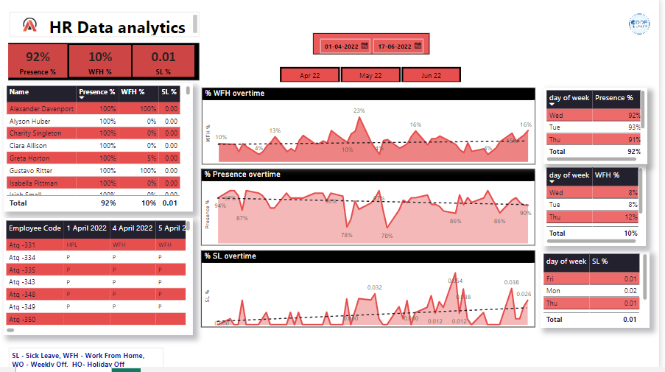
Visualization

Slide 7
Findings
Employee attendance data from Atliq was analyzed for the period April to June 2022.
The overall Presence percentage, WFH % and SL% obtained are 92%, 10% and 0.01% respectively.
The table chart was used to show % presence, WFH% and the SL% for every single employee working in the company.
The presence percentage was observed to be 94% in April, which was higher than May and June.
The percentage of employees working from home was 11% during May.
The number of sick leave taken was lower in April.

